Slide 1
<html>
<head>
<title>First</title>
<style>
p{
font-weight: bold;
font-style: italic;
font-size: 45px;
color: rgb(255, 196, 0);
text-shadow: 1px 1px 5px red;
text-transform: uppercase;
text-decoration:overline dotted rgb(215, 238, 4);
}
p.b {
font-weight: bolder;
font-style: oblique;
font-size: 35px;
color: rgb(0, 255, 85);
text-shadow: 1px 1px 5px red;
text-decoration:line-through wavy rgb(128, 47, 0);
text-align: start;
text-indent: 15pt;
letter-spacing: 10px;
word-spacing: 5px;
text-transform: uppercase;
line-height: 5px;
direction:rtl;
white-space:pre-line;
}
</style>
</head>
<body>
<p>CSS text style example</p>
<p class="b">CSS text style example1</p>
</body> </html>

Slide 2
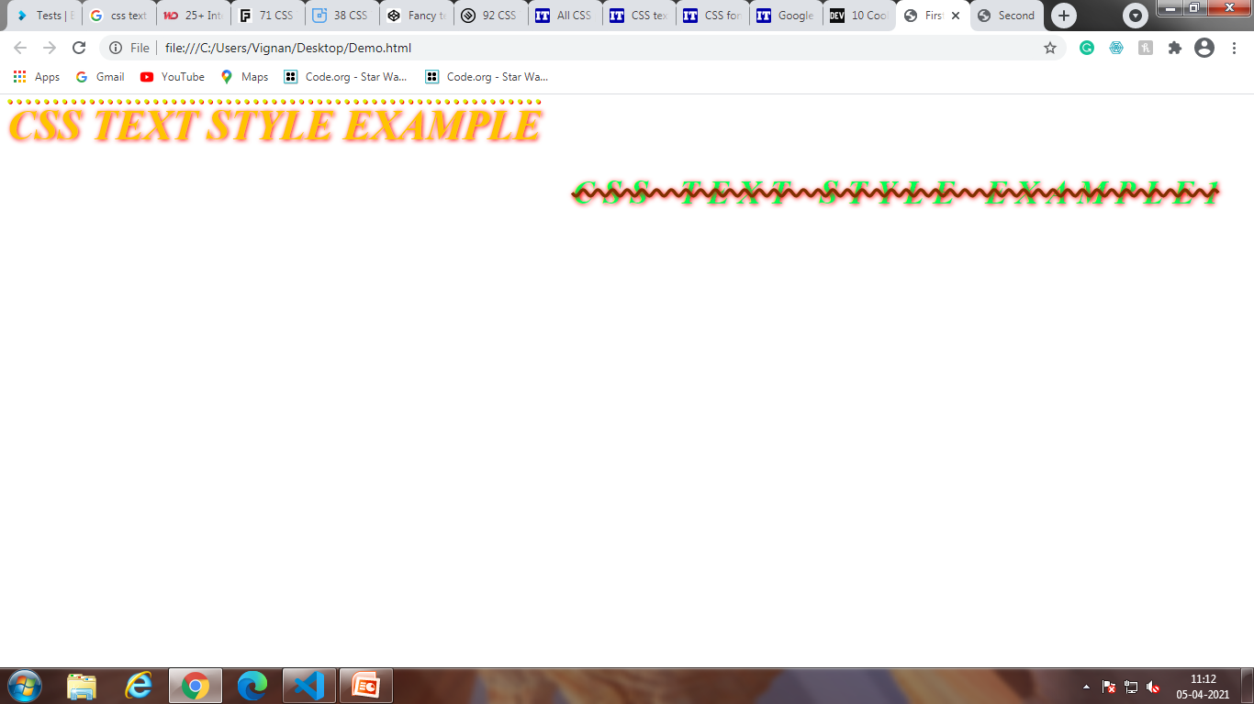

Slide 3
p {
font-size:55px;
font-weight: bold;
text-shadow: 0 1px 0 #ccc,
0 2px 0 #c9c9c9,
0 3px 0 #bbb,
0 4px 0 #b9b9b9,
0 5px 0 #aaa,
0 6px 1px rgba(0,0,0,.1),
0 0 5px rgba(0,0,0,.1),
0 1px 3px rgba(0,0,0,.3),
0 3px 5px rgba(0,0,0,.2),
0 5px 10px rgba(0,0,0,.25),
0 10px 10px rgba(0,0,0,.2),
0 20px 20px rgba(0,0,0,.15);
}
.g {
color: maroon;
}
.h {
color: rgb(241, 237, 9);
}
</style>
<body>
<div id="max">
<p class="g">CSS text style example</p>
<p class="h">CSS text style example</p>
</div>
</body>
<html>
<head>
<title>
Second
</title>
</head>
<style>
#max {
background-color: #00BFFF;
}

Slide 4
